Slide 1

Employee Data Analysis using Excel
STUDENT NAME: SUBALAKSHMI.M
REGISTER NO : 312212325
DEPARTMENT : B.Com(general)
COLLEGE : Shree Chandra Prabhu Jain College, Minjur.

Slide 2
PROJECT TITLE
Employee Performance Analysis using Excel

Slide 3


AGENDA
Problem Statement
Project Overview
End Users
Our Solution and Proposition
Dataset Description
Modelling Approach
Results and Discussion
Conclusion
3/21/2024 Annual Review

Slide 4

PROBLEM STATEMENT
When you know how well your employees perform, you can predict how well your company will perform. It helps to give incentive to employees.

Slide 5

PROJECT OVERVIEW
Employee data analysis is the process of using business information to create insights that can help make informed business decisions. It is a systematic approach to defining workforce problems and testing successful solutions. It helps to identify the employees performance .

Slide 6


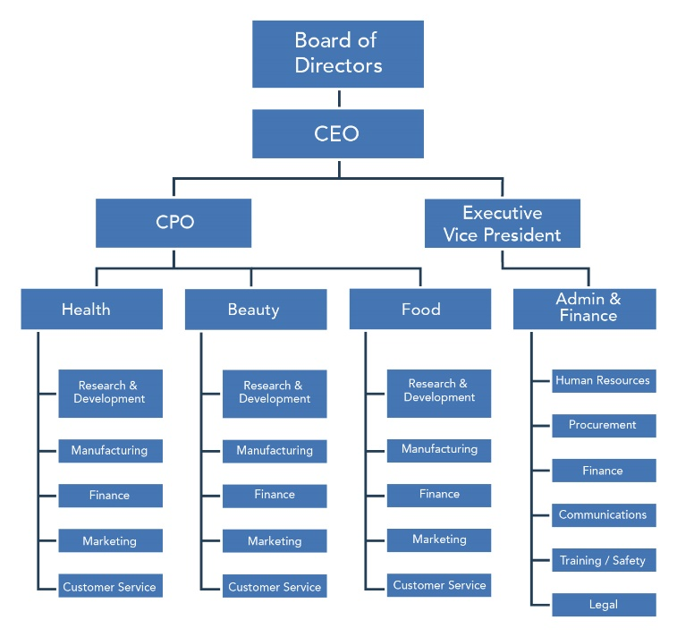


WHO ARE THE END USERS?
Manager
Worker

Slide 7

OUR SOLUTION AND ITS VALUE PROPOSITION
Conditional formatting – missing
Filter – remove
Formula – performance
Pivot – summary
Graph – data visualization

Slide 8
Dataset Description
Employee data set:
Kaggle website.
26- features
9-features
Analysis contain:
Employee id number
Employment type
Name – text
Performance level
Gender – Male or Female
Employee rating in numerical values

Slide 9

THE "WOW" IN OUR SOLUTION
TO CALCULATE
PERFROMANCE LEVEL OF THE EMPLOYEE USING FORMULA:
=IFS(z2>=5,”VERY HIGH’’,z2>=4,”HIGH”,z2>=3,’’MED’’,TRUE,”LOW”)
3/21/2024 Annual Review
9

Slide 10
step1: using Kaggle website we download one data set in it . Step2: now,download the data set and open the data set in excel. Step3: now remove the blank area using conditional formatting. Step4: Then fill the colour on blank cells.And go to filter option to remove the blanks cells. Step5: now, we calculate employees performance level in a numerical values.we create a formula to convert a numerical values to identify their level.ie: VERY HIGH, HIGH,MEDIUM,LOW etc. step6: next step is pivot table. Using pivot table we make gender vice analysis,and many details .
MODELLING
Steps for performance analysing using excel:
10

Slide 11
Step7: Then using slice option to create a different catergiores of filters. Step for prepare a graph: step1: Go to insert option then click recommended graph then choose one graph on it. Step2: now we have a graph for the analysis .we can edit the options like female and male categories. Step3: Last step give the title for the graph.

Slide 12
RESULTS
12

Slide 13
FEMALE EMPLOYEES ANALYSIS
Result:

Slide 15
conclusion
By comparing the performance of the employees the number of employees are higher in the low
performance . So we try to motive those employees are improve their performance into higher level. In this result we saw the very high performance employees are less.
In the conclusion of this project is low performance employees are higher. we encourage the employess to different levels of task to active in the work.

